Slide 1
Better Castings
Casting Confidence
The word “Better” was founded on the concept of delivering a “ Better Product” with fire in the furnace

Slide 2
Vision
To be a Globally reputed
pipe end product
manufacturer

Slide 3
Mission
A one stop solution for the customer needs with full range of products in the operating sector

Slide 4
Quality Policy
“We at Better Castings are committed to meeting Customer and Product requirements, complying to legal requirement and continually improving the quality management system addressing the quality objectives”

Slide 5
HSE Policy
PREVENTION AND CONTROL OF LAND, AIR AND NOISE POLLUTION
CONSERVATION OF NATURAL RESOURCES. DEVELOPING GREEN ZONES IN AND AROUND PLANTS AND OFFICES.
COMPLIANCE WITH APPLICABLE ENVIRONMENTAL LAWS ,RULES AND REGULATIONS.
NOT TO EMPLOY PERSONS BELOW 15 YEARS OF AGE
PROVIDING A SAFE AND HEALTHY ENVIRONMENT AT WORK PLACE
INCULCATE AWARENESS AMONG ALL EMPLOYEES, CONTRACTORS AND VISITORS REGARDING HEALTH, SAFTEY AND ENVIRONMENT.
AQUAIRING WORLD-WIDE BEST PRACTICES IN HEALTH SAFTEY AND ENVIRONMENTAL MANAGEMENT.
TRANSPARENCY IN OUR HEALTH, SAFTEY AND ENVIRONMENTAL PRACTICES.

Slide 6
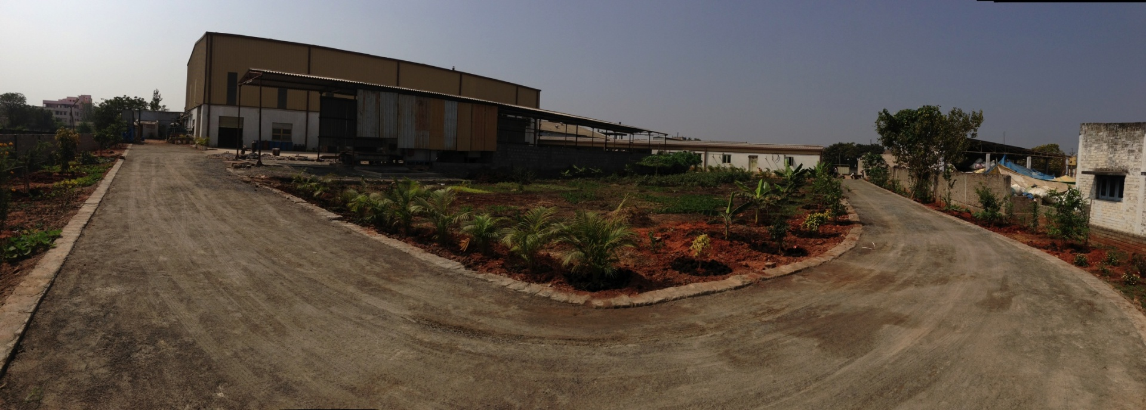
Facilities - Infrastructure
Total Ares 2220
Covered Area Sq.ft.
Connected Load 750 KVA ( 1200 KVA)
Back Up Power 650 KVA

Slide 7
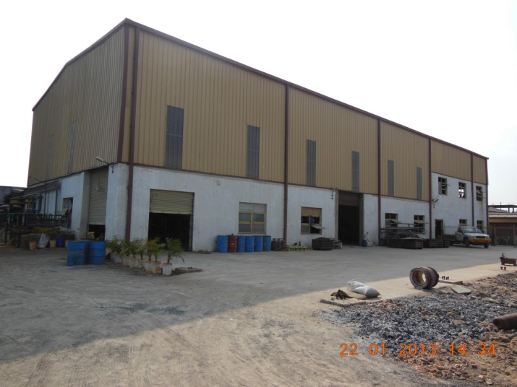
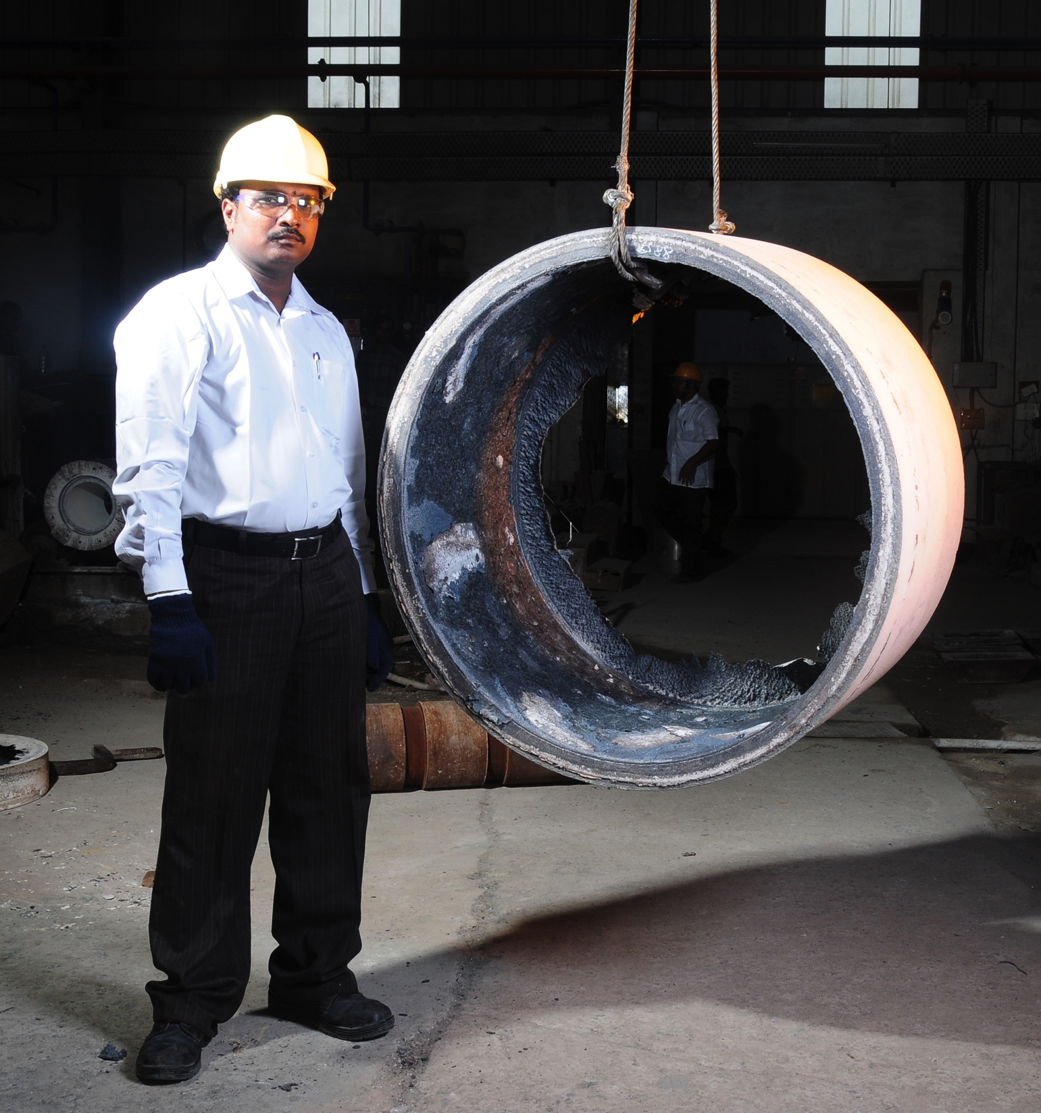
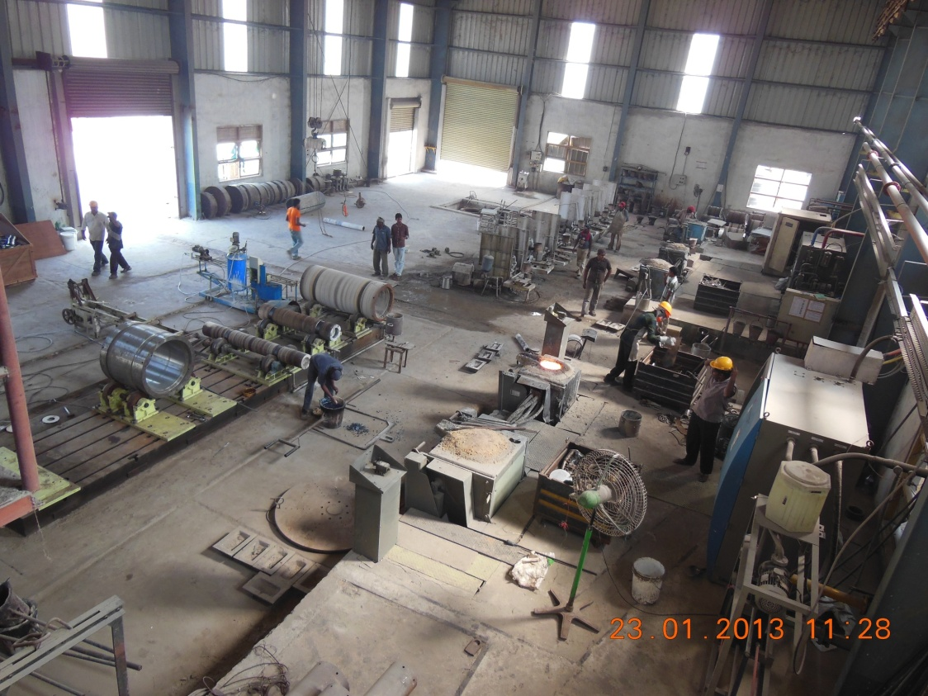
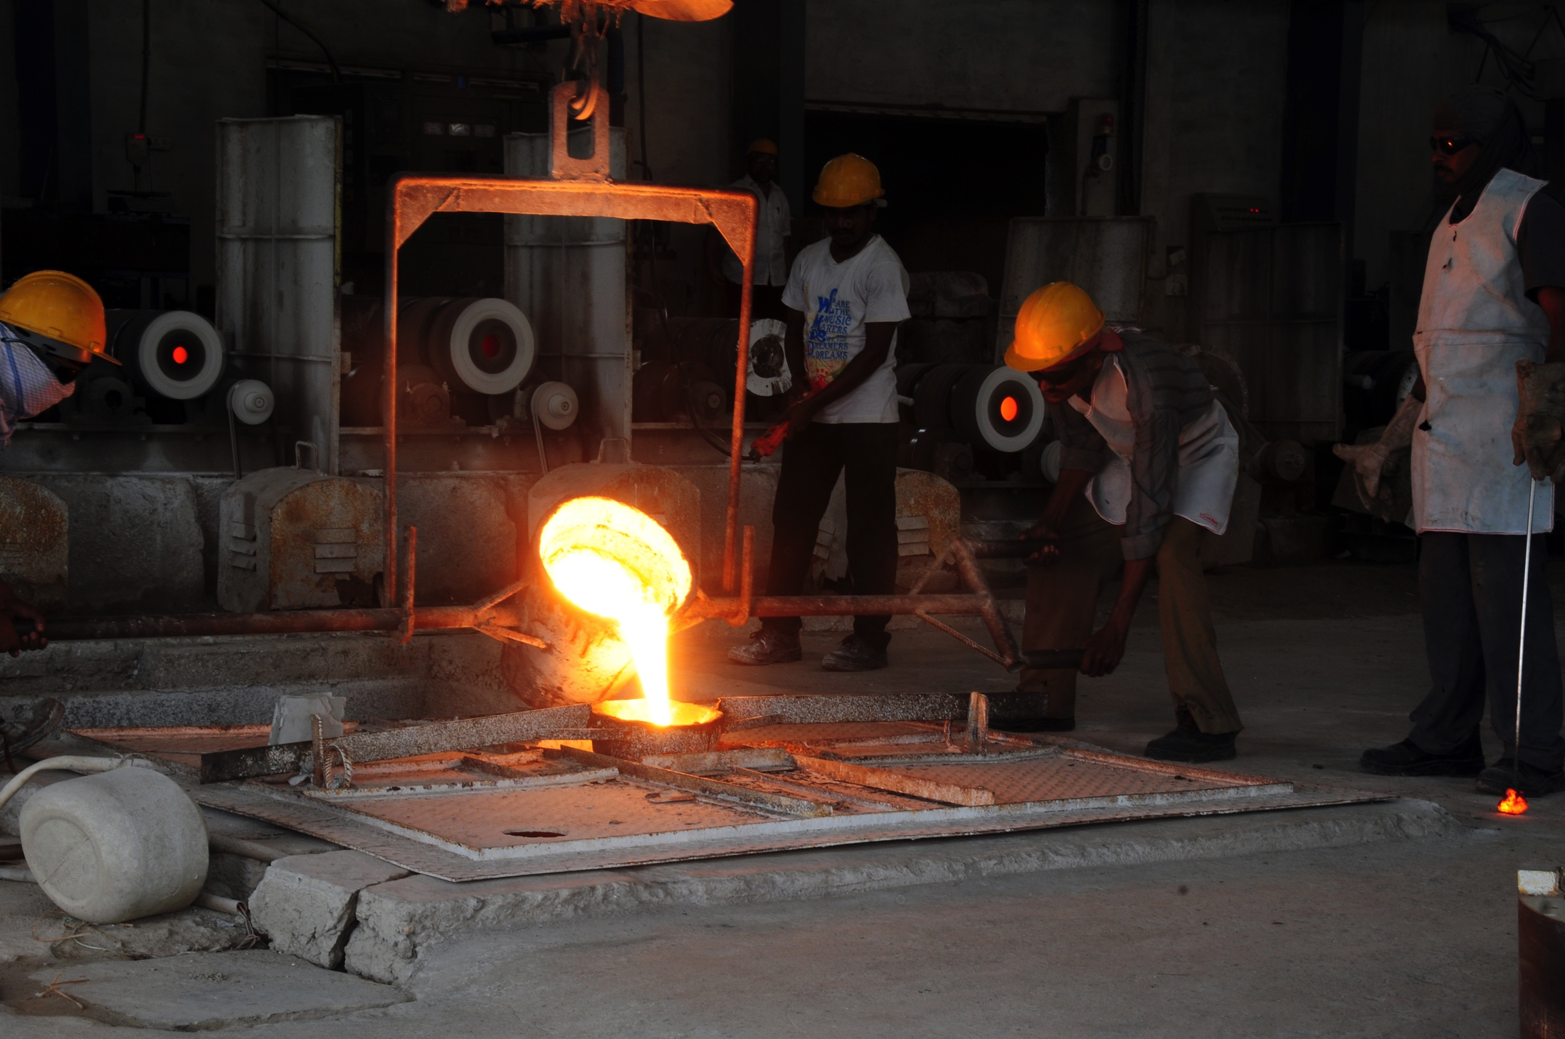
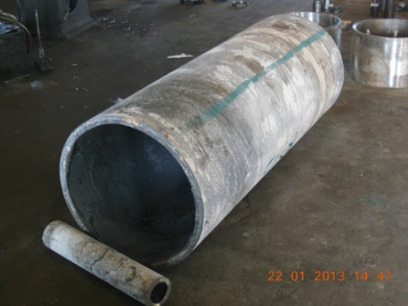
Facilities -Foundry
Melting: 350 KW and 125KW power panels with a rated out put of 650 Kg/Hr and 300 MT p.m
Horizontal and Vertical CC Machines with max OD of 1100 mm and min ID of 25 mm
Max pouring wt limited to 750 (1250)Kg

Slide 8
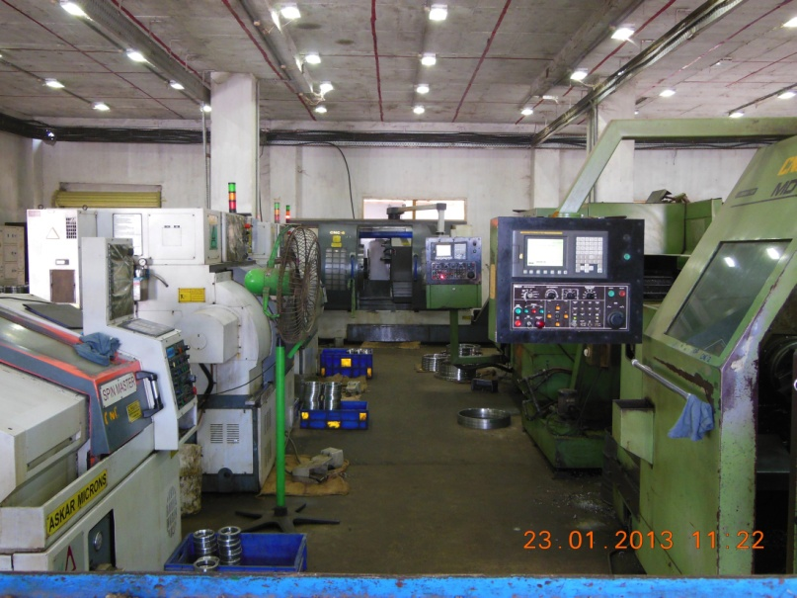
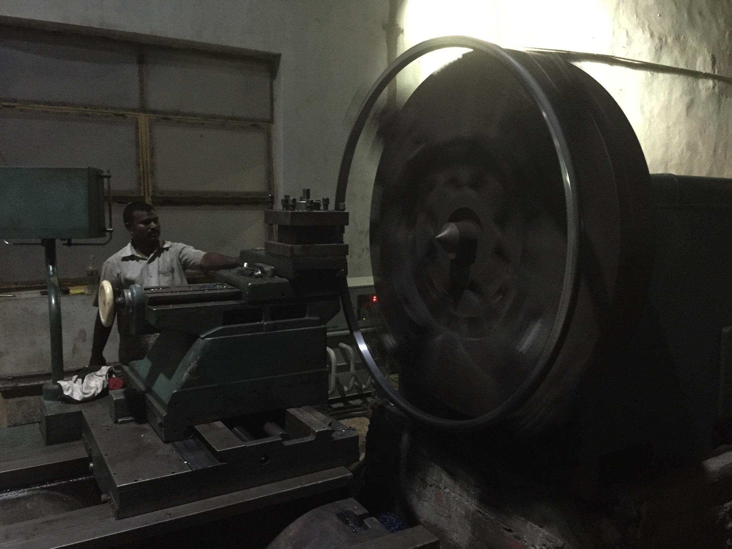
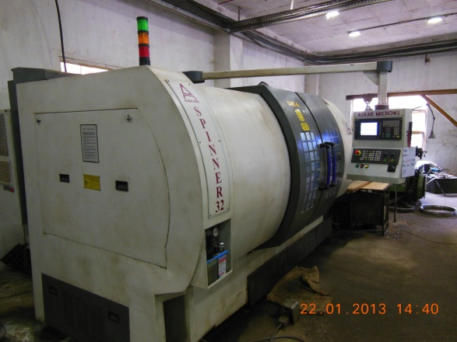
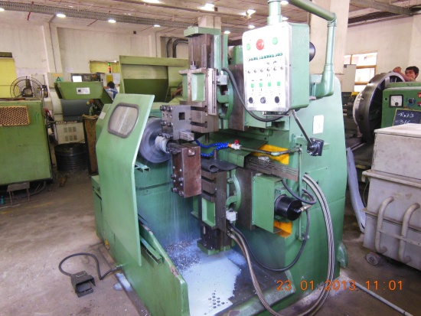
FACILITIES – MACHINE SHOP – 1.8M
Lathes ( 15 nos)with max turning diameter of 1800 mm and length 3000mm
CNC Lathes ( 13*) with max turning dia of 1250 mm and length 1000 mm
Facing Lathes 2 Nos with Max turning dia of 1450mm and Length of 300mm
SPM for proof machining of ID & OD simultaneously 2 nos
* 3 nos at Chennai

Slide 9
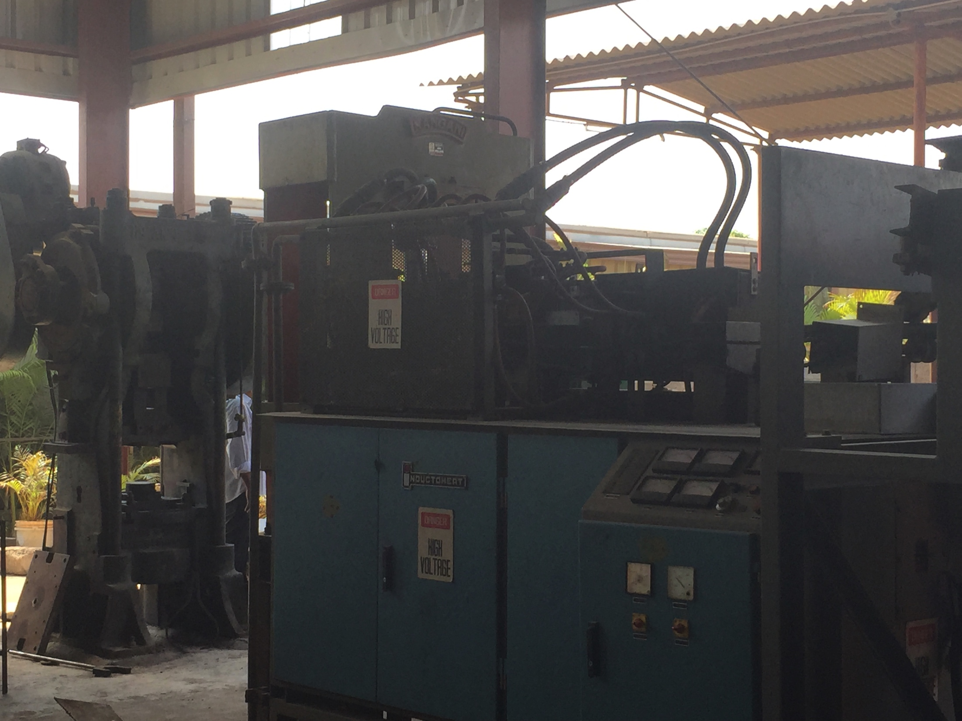
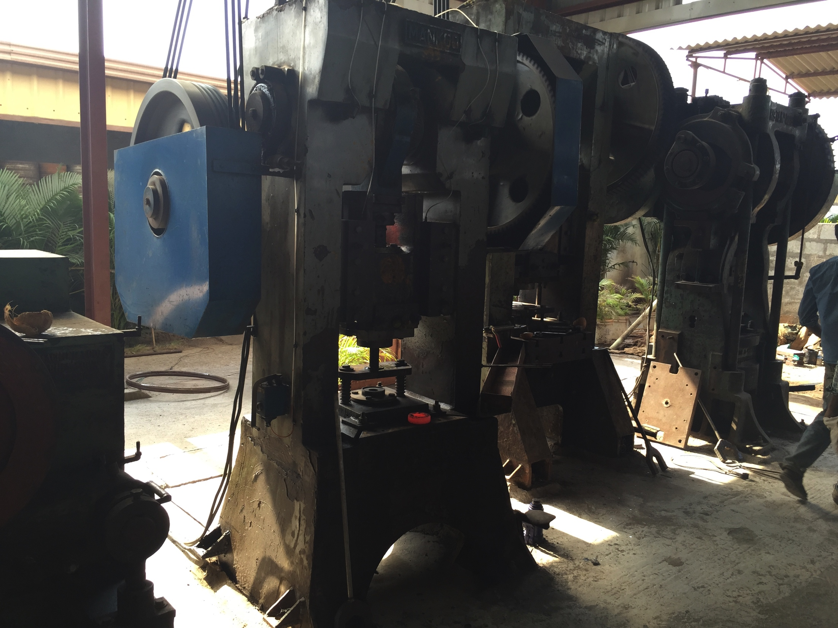
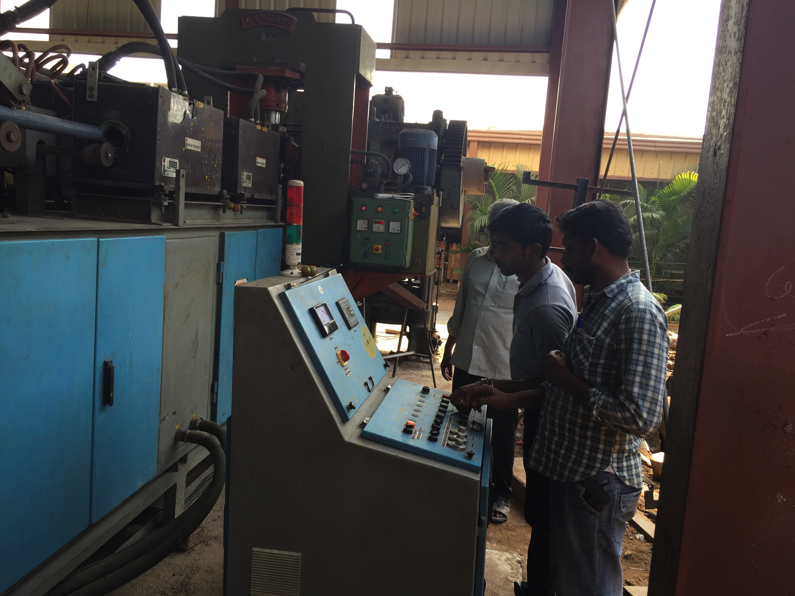
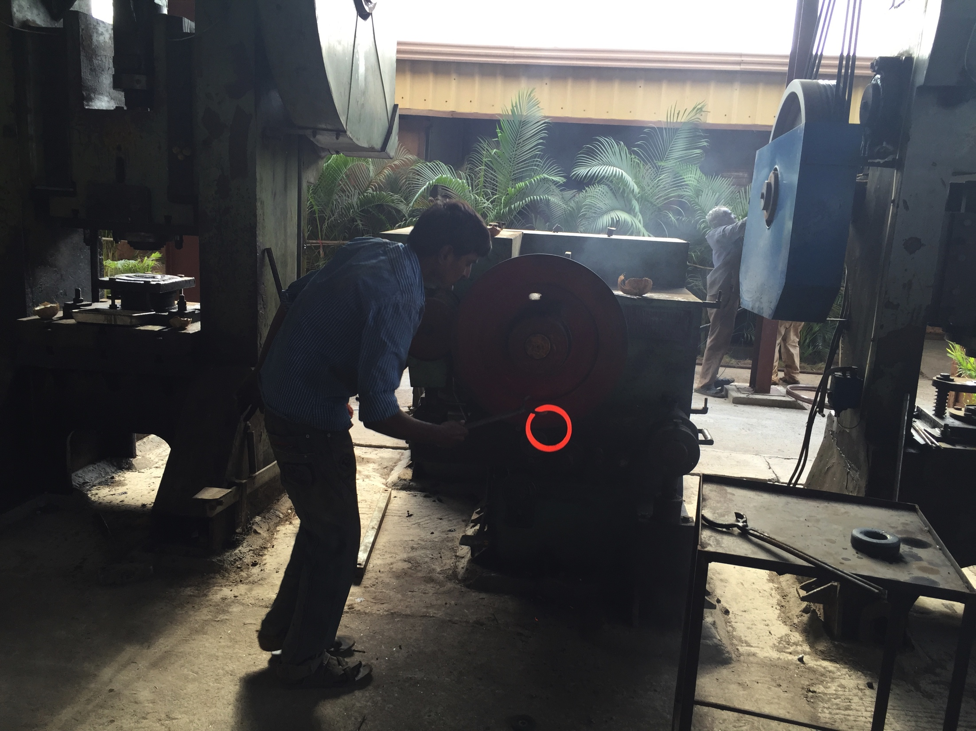
Facilities – Ring Forging – 75MT p.m
250KW Induction Rod Heater
Hot Shearing Press
250 MT Blanking Press
250 MT Piercing Press
250 MT Piercing Press
300mm Ring Rolling m/c
300 MT Sizing Press
- Oil Fired Blank Heating Furnace
300MT Hydraulic Press
65 Sq Rolling Machine
1 MT Annealing Pit Furnace 3 Nos
300mm Hydraulic Bandsaw

Slide 10
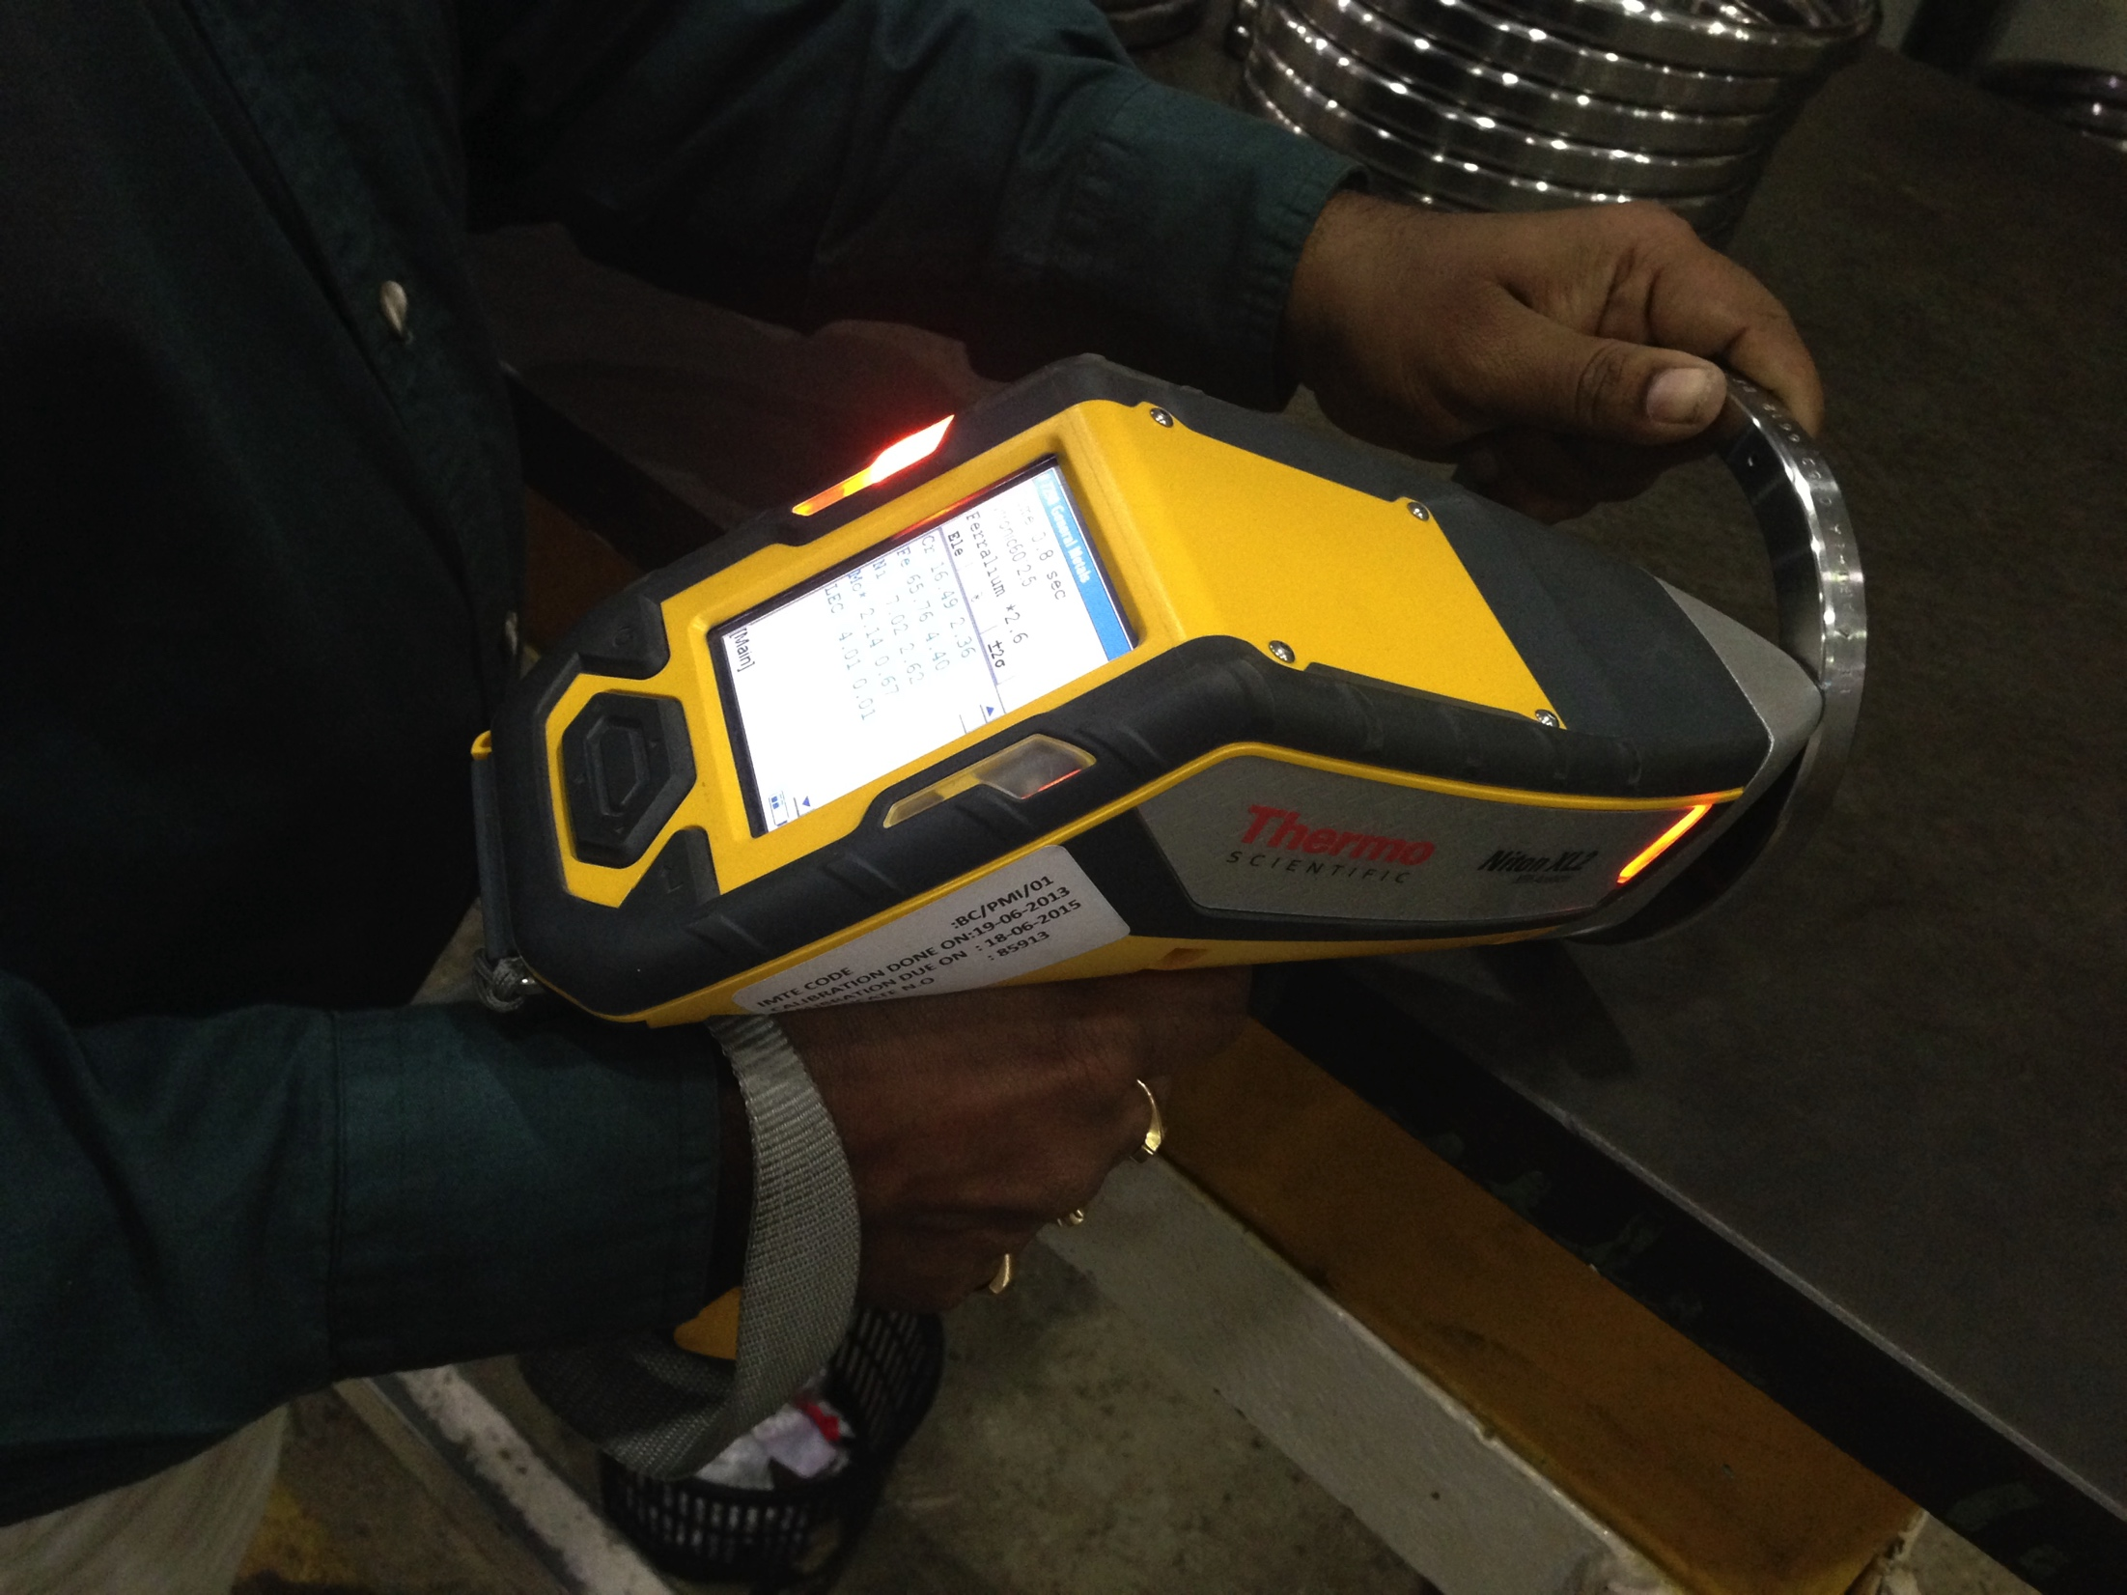
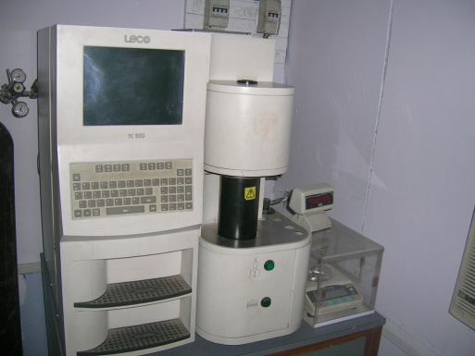
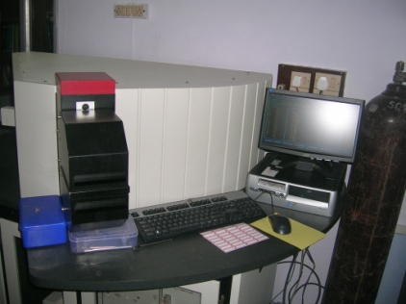
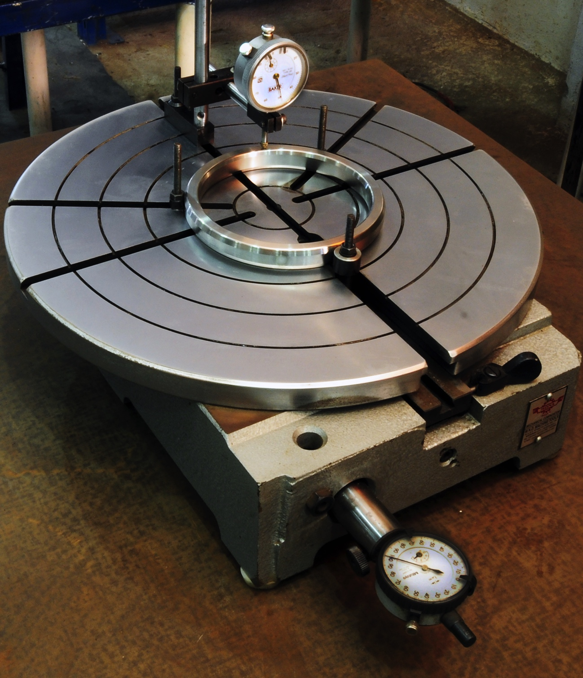
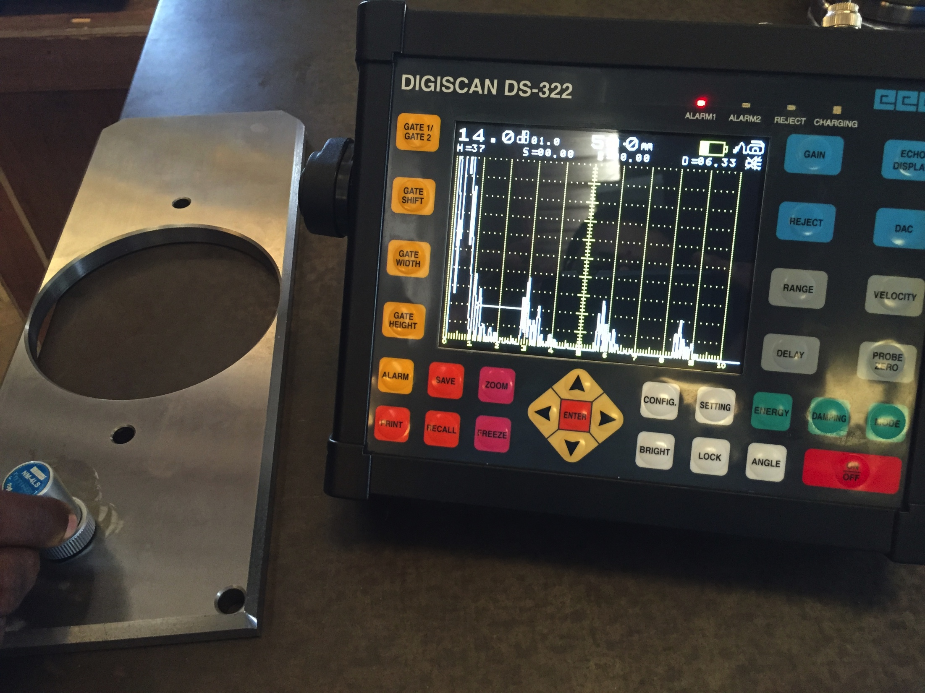
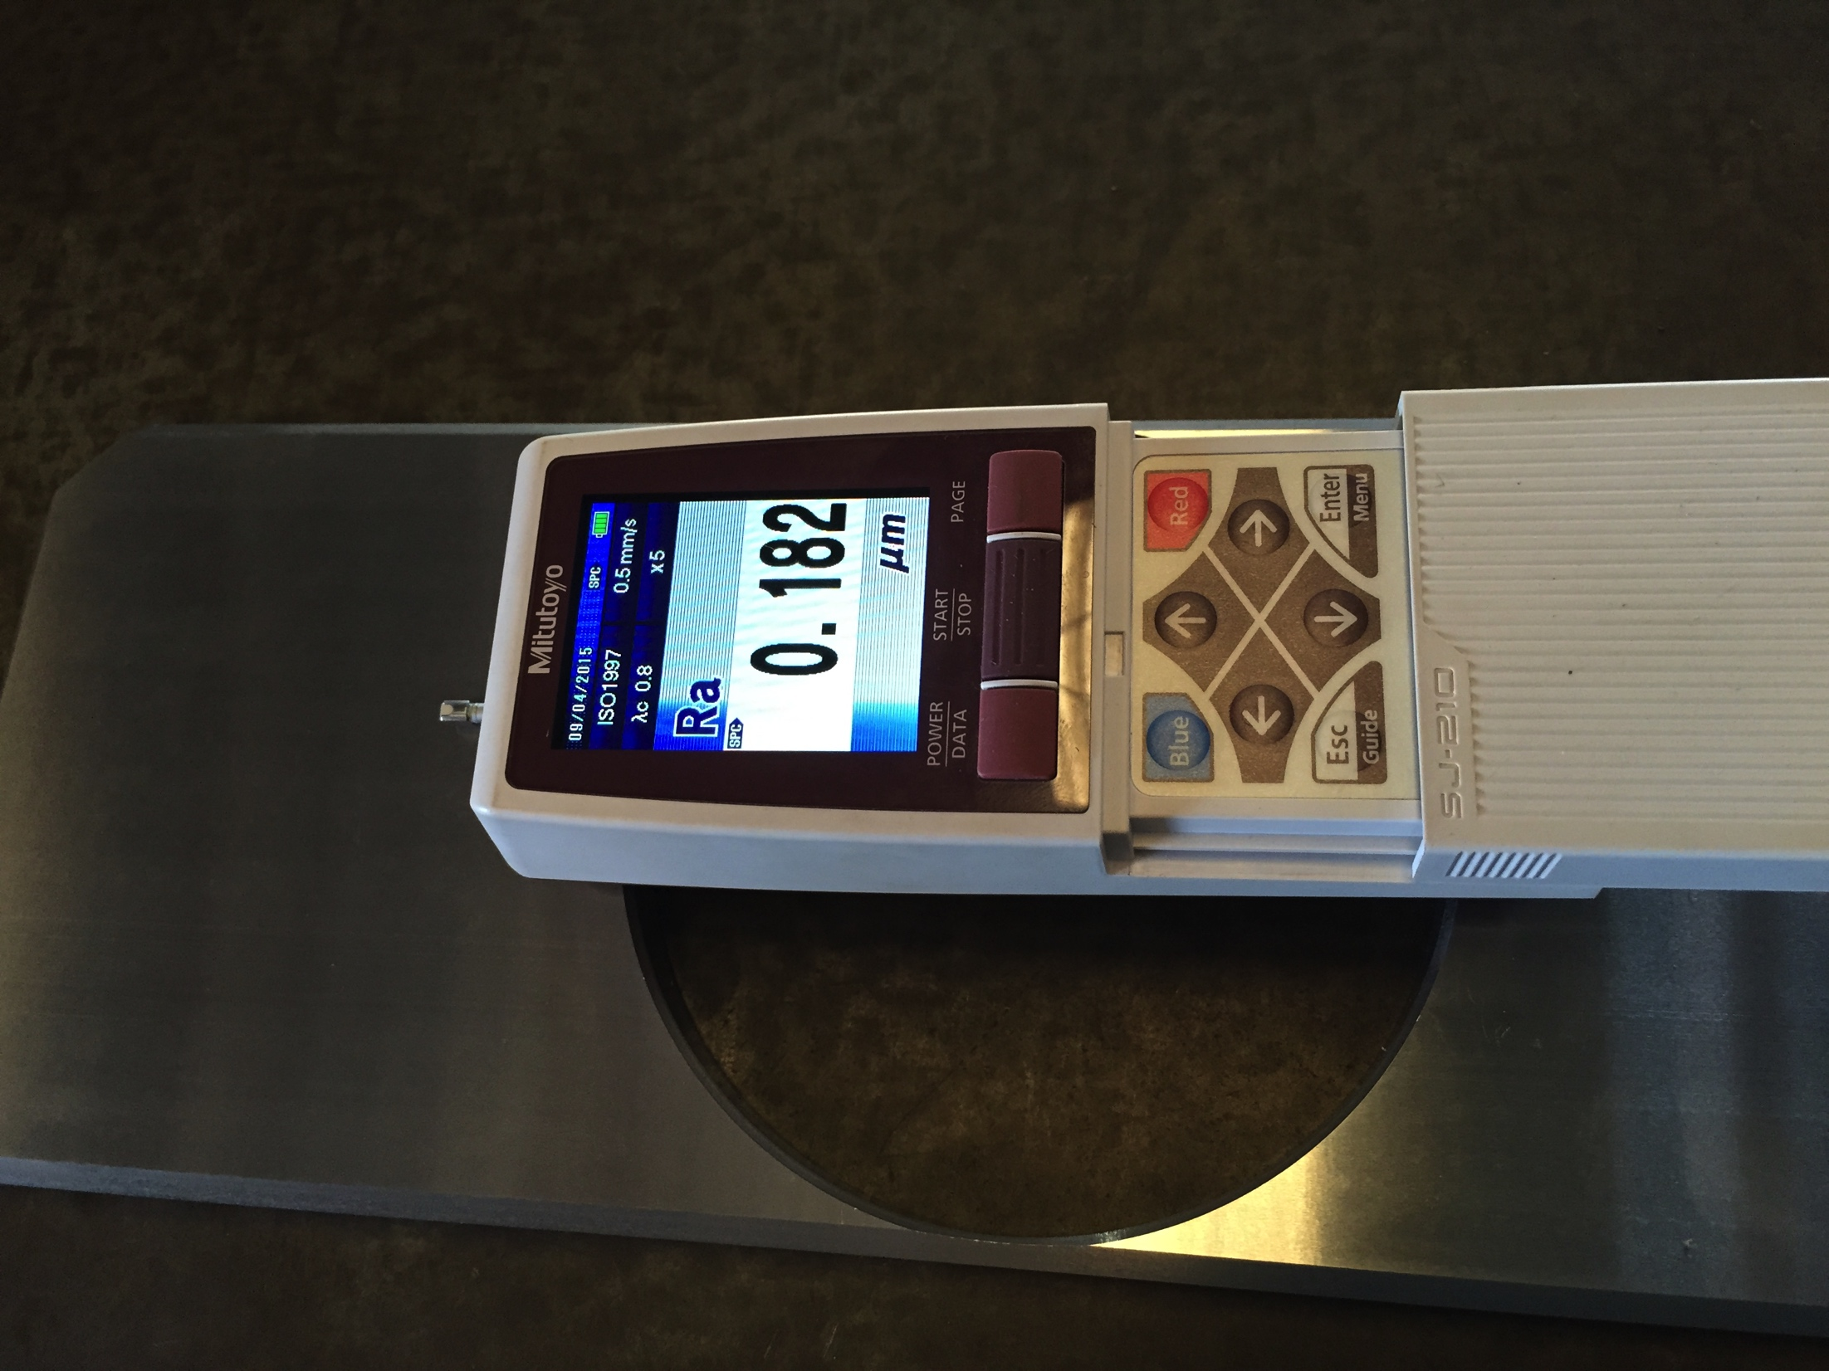
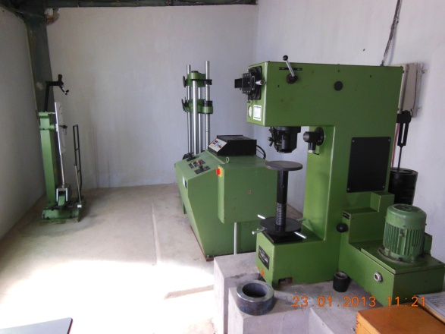
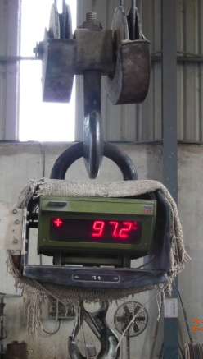
Facilities - QC
WAS 21 channel CCD spectrometer.
Baird DV-6 1000mm 41 channel 6 base spectrometer
NITON PMI Analyser
Leco TC-500 oxygen and Nitrogen Analyser
20MT UTM
Impact Testing M/c
Portable Hardness Tester
Metallurgical Microscope
Radiation Monitoring meter
Surface roughness measuring meter
Ultrasonic Testing M/c
Coating thickness measuring meter
Height Gauge, Digital Vernier, Pyrometers

Slide 11
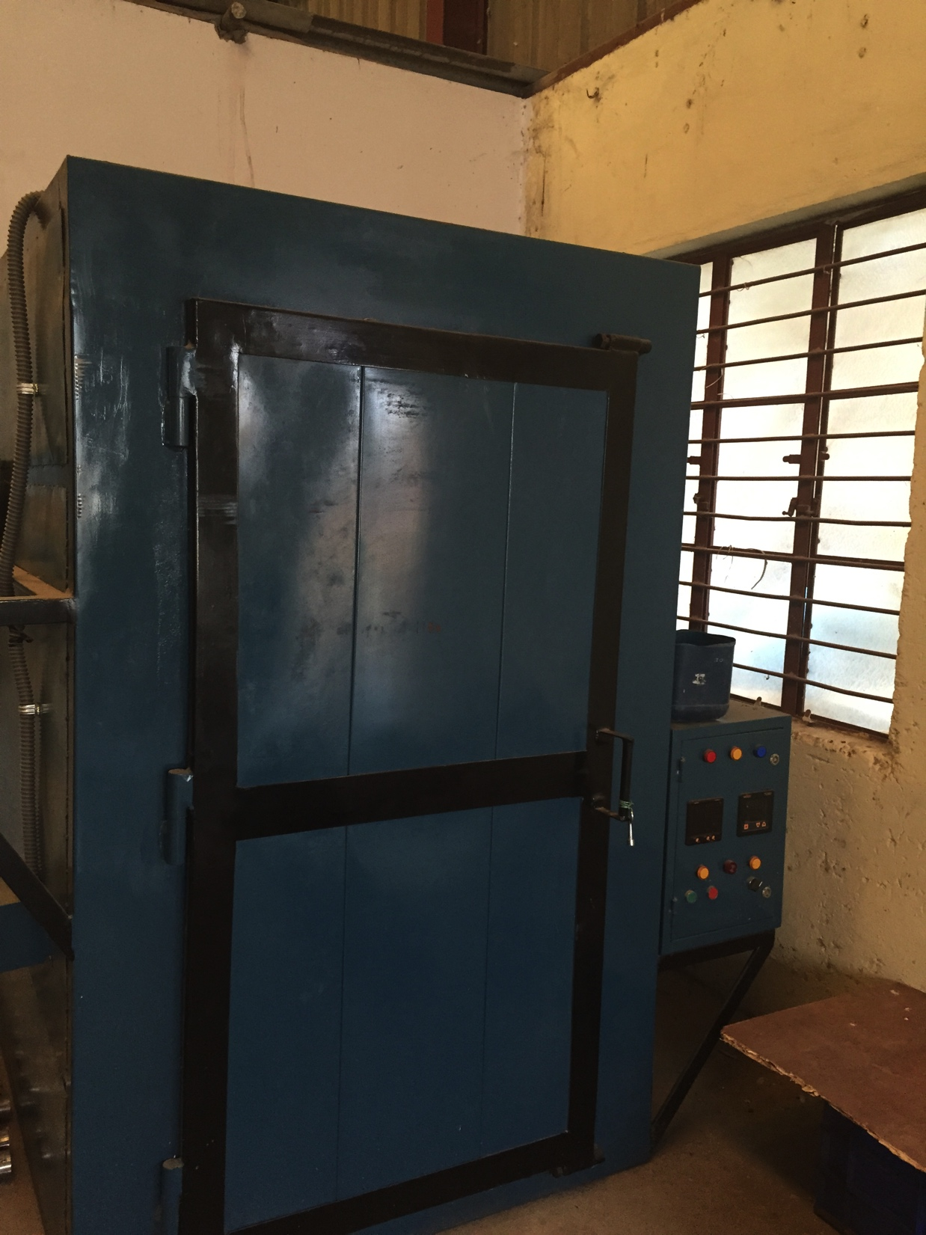
Facilities – Electro Plating
Zinc Plating with Yellow / Blue Passivation
Capacity: Max Dia of Ring 1500mm
Qty – 1000 Pcs per day

Slide 12
Metals cast
Stainless Steel: 316,316L,304,304L, 321,347, 317,317L,309,310,410,430,904L, 17-4 PH, Duplex, Super Duplex, Alloy 20, Alloy 28,
INCONEL: 625,825,600,800, 718, Monel 400, Monel 500, Monel M30H,
Hastelloy C-276
Alloy Steel WCB,LCB,LCC, F5 , F12
Non Ferrous: Copper Based – PB2, LB4, AL Bronze.

Slide 13
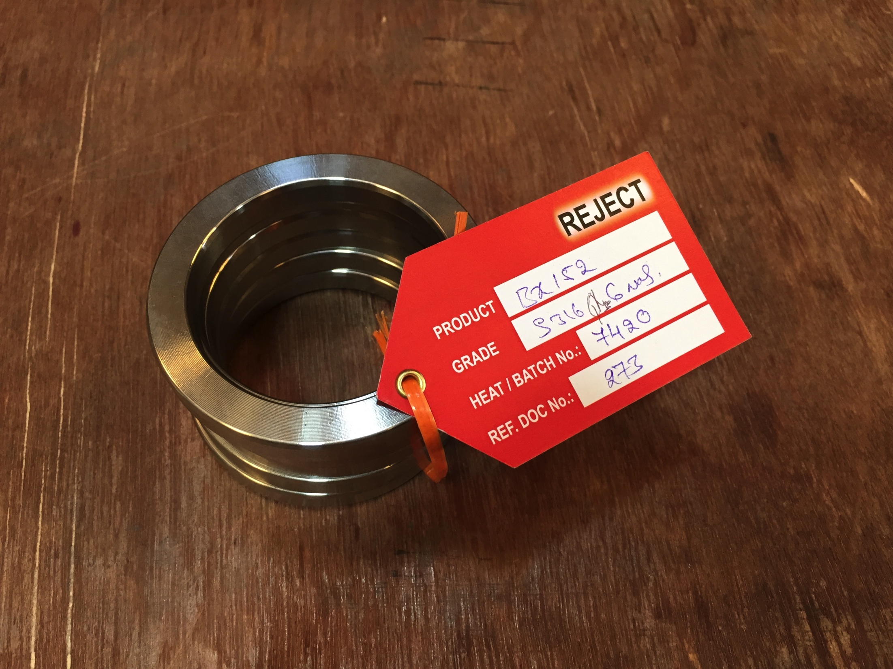
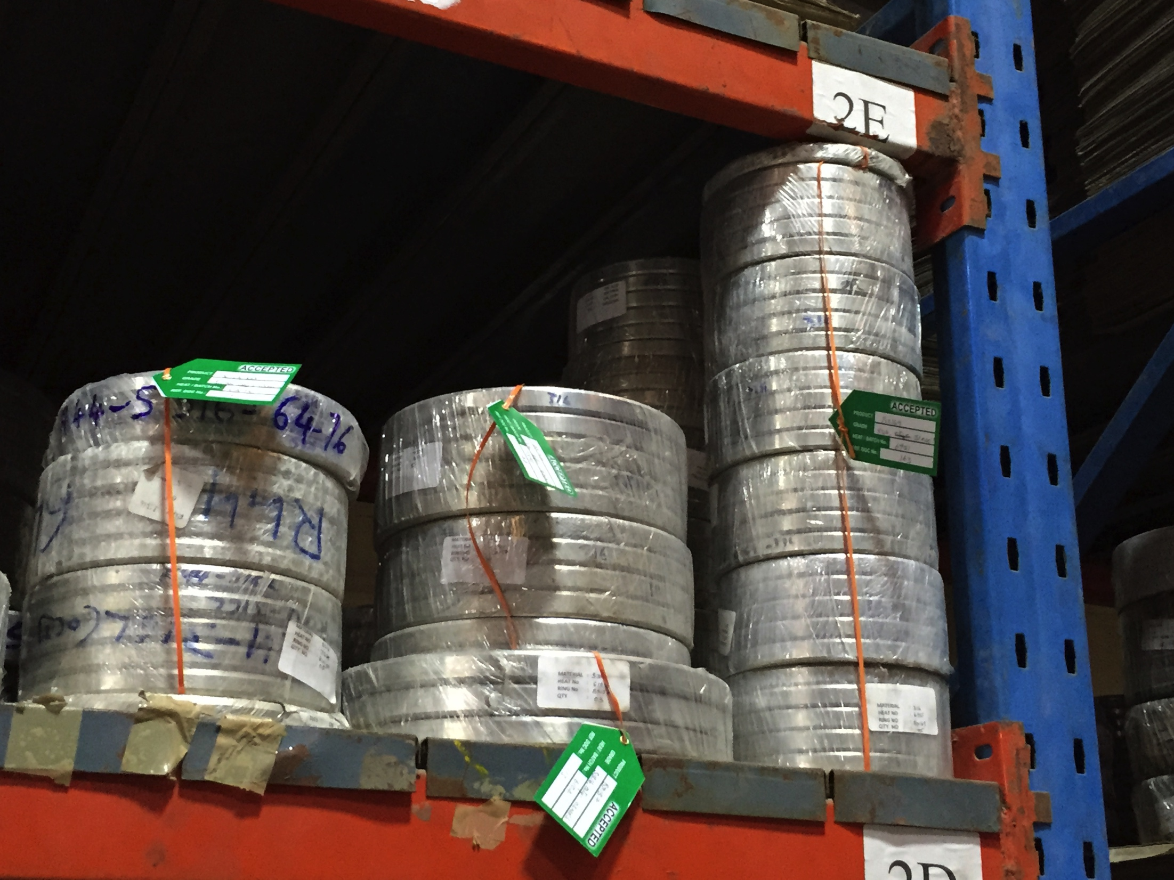
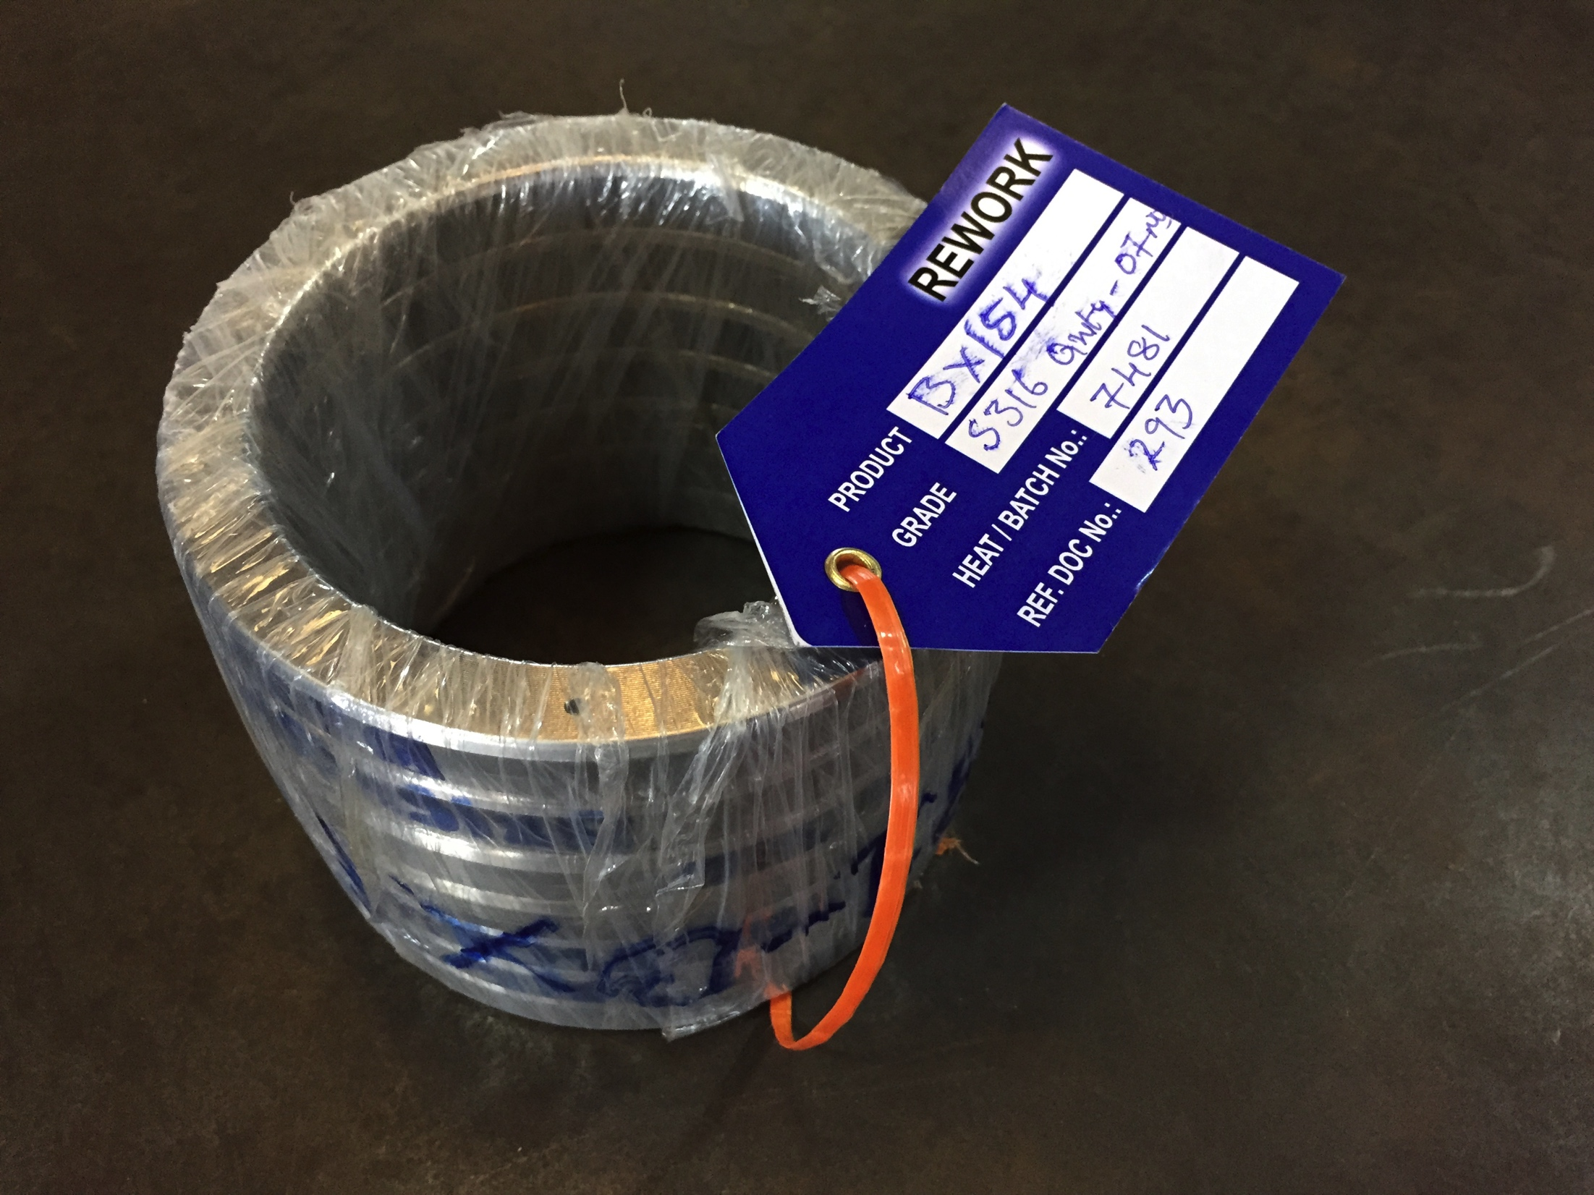
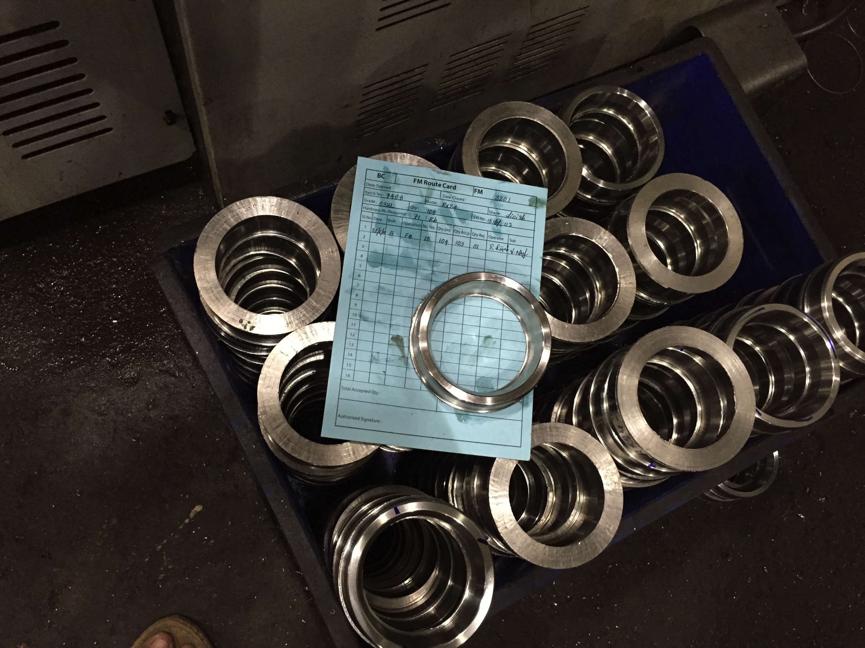
Identification & Traceability
Casting ID- Punched on the face of the casting
IN Process ID- bundles rings identified by color coded tags
Material Travels - with Route Card

Slide 14
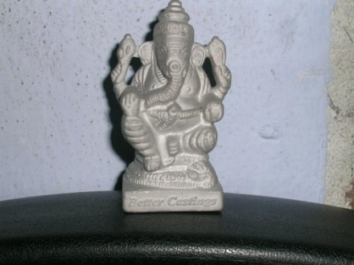
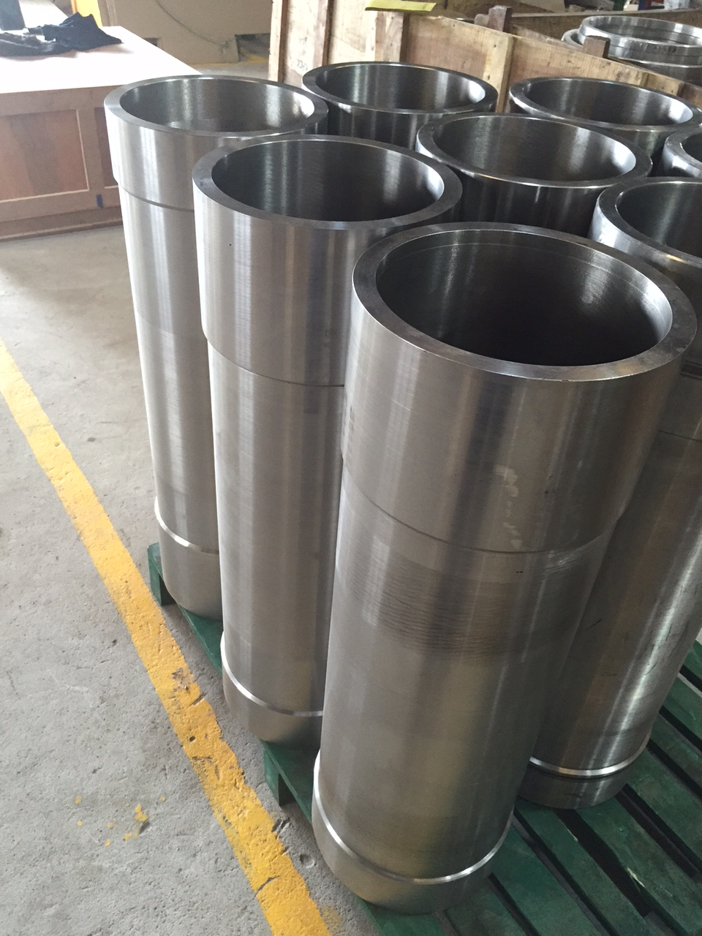
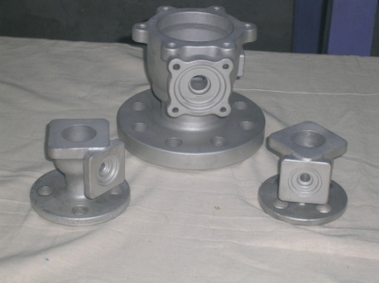
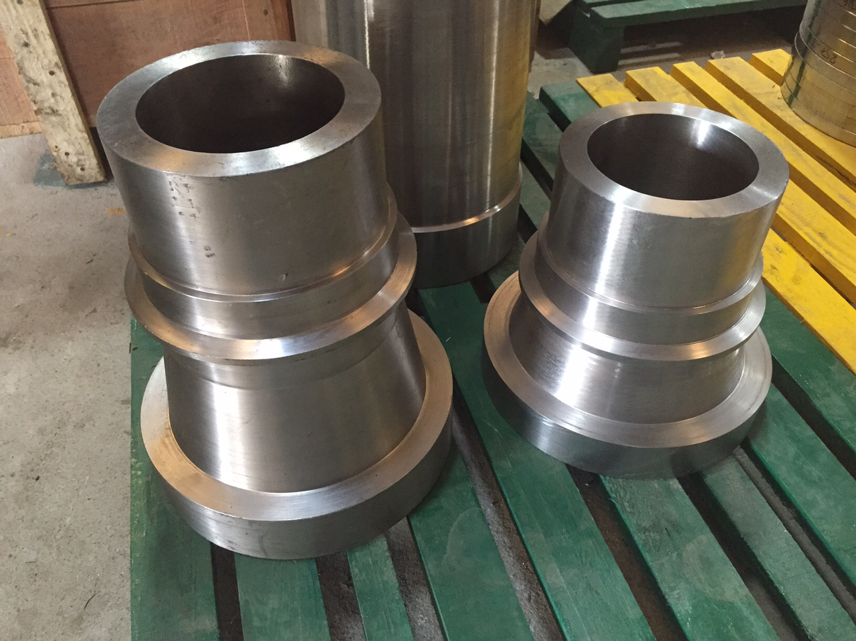
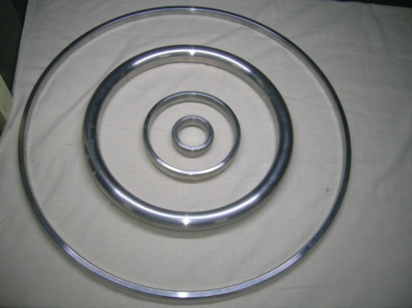
Products
RTJ Gaskets
Valve Components
Pump Components
General Engineering Components
Boiler components
Decanter components

Slide 15
Product Progress
2001:Centrifugal Casting of Stainless Steel - proving as an economical alternative to forged rings
2002:Development of Air nozzel castings with 30mm ID and 800mm length
2003:Development of Inconel 625 Castings
2004:Development of flanged castings
2005:Development of Duplex and Super Duplex Stainless steel
2006:Developed Inconel Gr 718
2007- Developed Hastelloy C-276
2008- Developed Investment Castings
2009-Developed M30H grade for Valve seat rings

Slide 16
Recognitions
2004
JRD Tata IEA’s “ Best Entrepreneur”
2005
Pearl’s of AP Best SSI Entrepreneur
2012
Eminent Engineer

Slide 17
Path tread
2001
Started commercial production of castings as a jobbing foundry employing green sand, centrifugal, shell molding and Air Set molding process
Products made R& AC Components, Heat Exchanger, two wheeler cylinder blocks, glass molds, shot blasting wear components and pump components.
2002
Started establishing in centrifugal casting of stainless steel
Reached Commercial Break Even
2003
. Strengthened quality with a Spectrometer

Slide 18
Path Tread
2004
ISO Certified
2005
Started first exports to M/s Smith International –UAE
2006
Introduced Leco Oxygen Nitrogen Analyzer
2007
Introduced CNC Lathes making finished products
2008
Initiated Investment Casting project
2009
Development of API Certified RTJ Gaskets and Valves

Slide 19
Why Better Castings
For
Adaptability
Entrepreneurship
Customer Focus
Young Organization with a vision
Scalability
Scrap to Finished Goods Under One Roof.
Short Falls
Location Disadvantage ( One day away from Port)
Organization Size ( neither small nor big)

Slide 20
The Base
K Radhakrishana – GM (New Business Development) – An Engineering Graduate with over 27 yrs experience in the field of Gasket Marketing
K Ratna Giri- GM ( Operations) Engineering Graduate with 27 years experience in Manufacturing
K Lakshmi – GM ( Administration ) Graduate with over 25 Yrs experience in office administration
JSRK Prasad – C E O –Post Graduate in Metallurgy from PSG Tech, with over 22 Yrs experience in the field of foundry and manufacturing. Trained in a Swiss foundry and in lean manufacturing in Japan. A first Generation Technocrat.

Slide 21
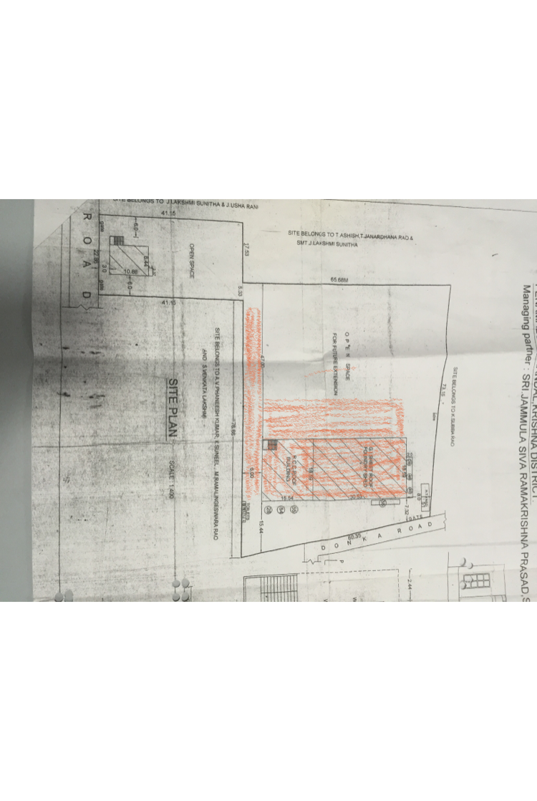
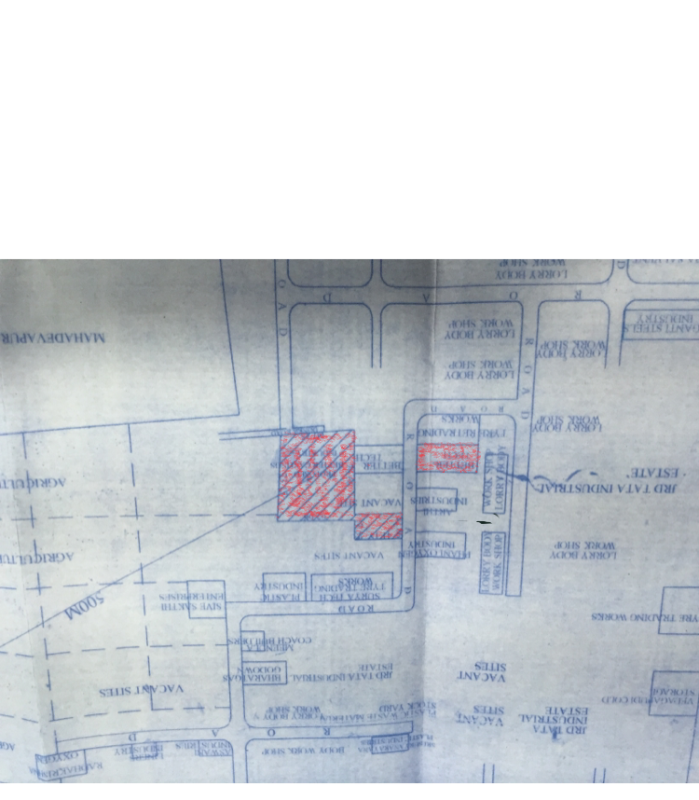
Location _ Zippr Code – YJQU3941

Slide 22
THANK YOU FOR YOUR INTREST IN BETTER CASTINGS AND THE TIME SPARED FOR US

